Slide 1

MOSS: Mask-Oriented Open-Set for 3D Scene
Segmentation using Superpoint
Nov 2024 - ?
Hongrui Wu
Tongji University
Notes:
* This smiling green spherical characteris is a prompt-generated kawaii-style cartoon representation of MOSS.
* If you've seen The Wandering Earth, MOSS actually shares its name with the superintelligent AI system in the film, which appears as a large camera-like structure.
We present MOSS (Mask-Oriented Open-Set for 3D Scene Segmentation using Superpoint),
a novel framework for open-set 3D scene semantic segmentation.

Slide 2
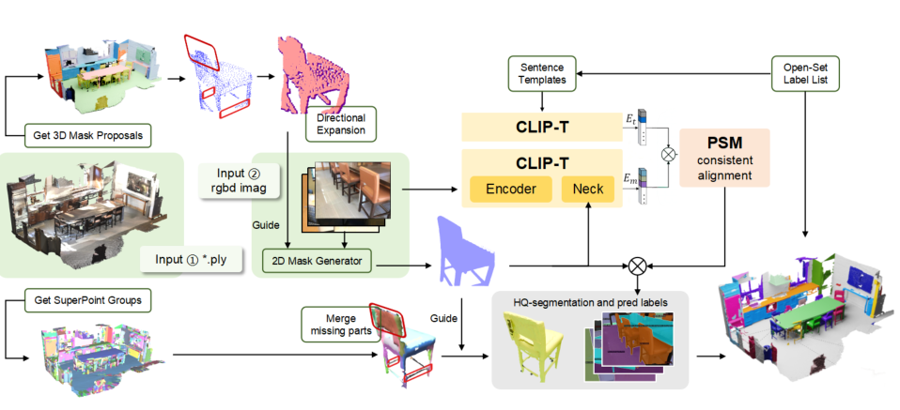
MOSS: Mask-Oriented Open-Set for 3D Scene
Segmentation using Superpoint
Nov 2024 - ?
Hongrui Wu
Tongji University
Notes:
here is the pipeline figure:
now we introduce our approach in the order of the contributions outlined.

Slide 3
MOSS: Mask-Oriented Open-Set for 3D Scene
Segmentation using Superpoint
Nov 2024 - ?
Hongrui Wu
Tongji University
Notes:
* This smiling green spherical characteris is a prompt-generated kawaii-style cartoon representation of MOSS.
* If you've seen The Wandering Earth, MOSS actually shares its name with the superintelligent AI system in the film, which appears as a large camera-like structure.
We present MOSS (Mask-Oriented Open-Set for 3D Scene Segmentation using Superpoint),
a novel framework for open-set 3D scene semantic segmentation.

Slide 4
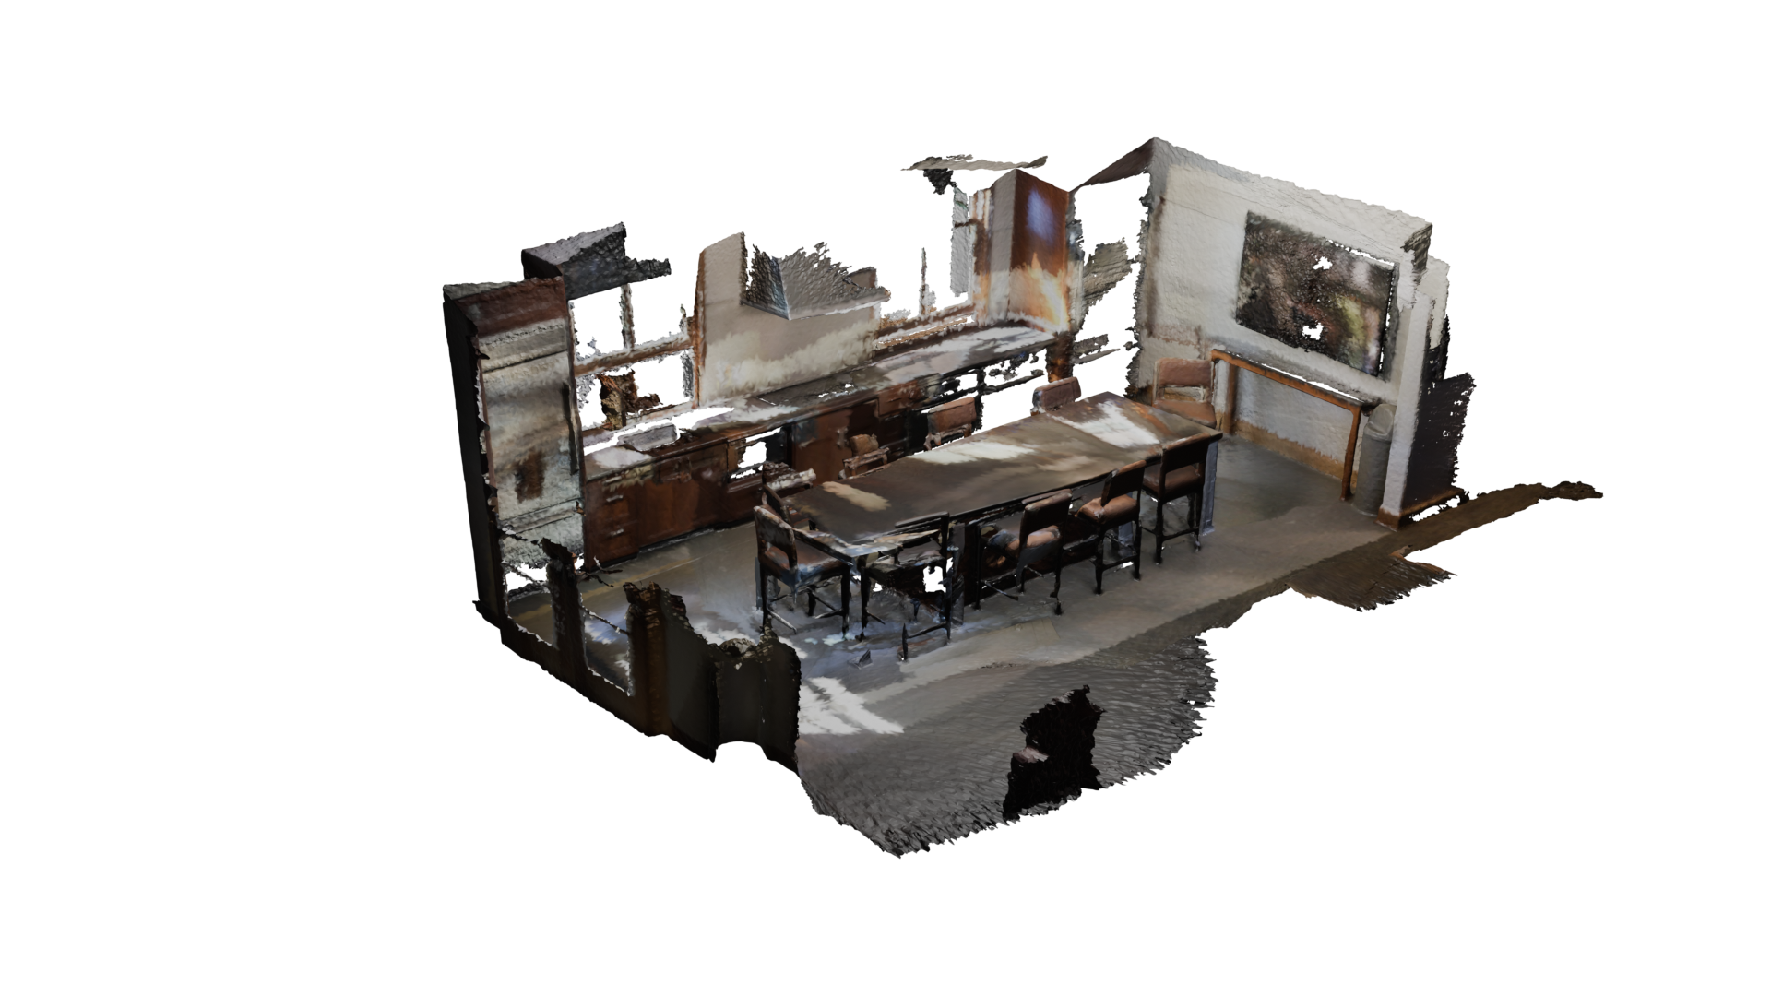
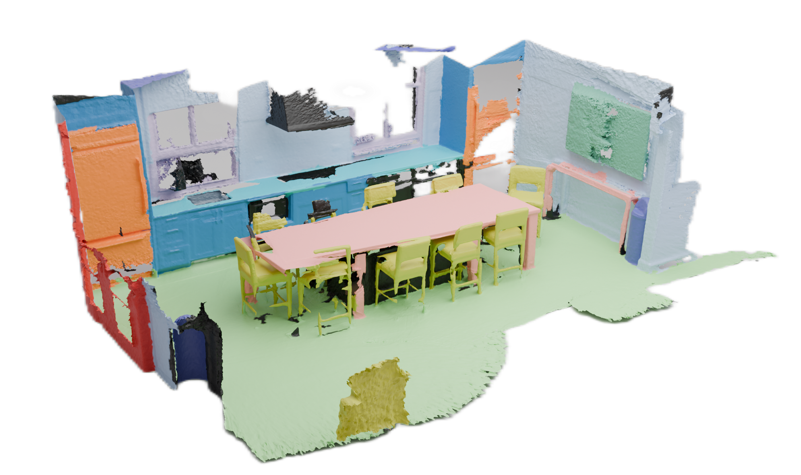
Task Background
Traditional methods rely on densely annotated 3D scenes.
Have to utilize supervision from ground truth labels.
3D Annotation is Time-consuming and Expensive!
Input 3D Geometry
Annotated 3D scenes
Notes:
traditional approaches to 3D scene understanding utilize supervision from dense annotation
which is quite Time-consuming and Expensive

Slide 5
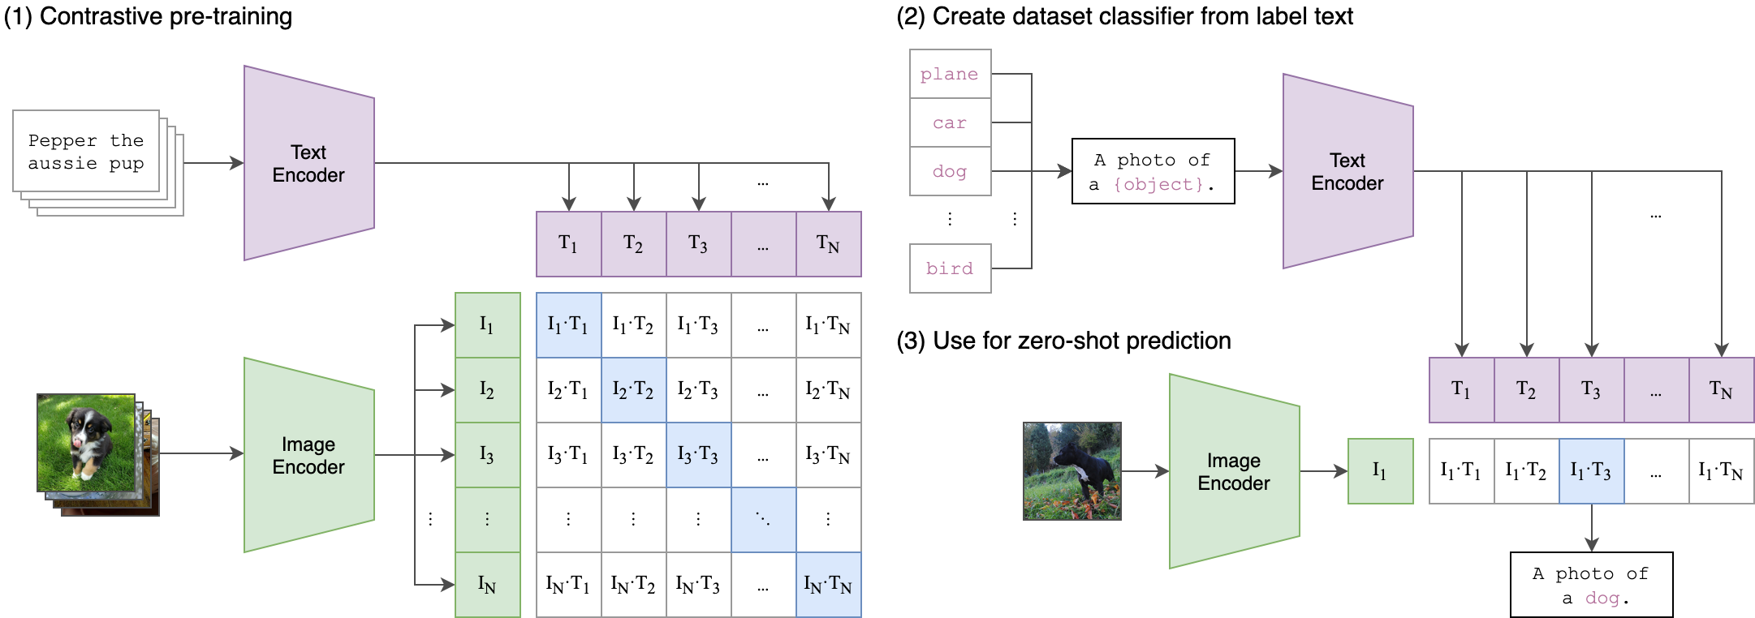
Task Background
Meanwhile computer vision is going through a transition from the previous closed-set perception to open-set perception:
Closed-set: only handles predefined classes during training
and has limited capability in dynamic world
Open-set: understands unseen, diverse and free-flowing language,
mimicking how humans naturally interact with the world and each other
2D open-set tasks can now understand new concepts, perform accurate segmentation and detection, and handle complex tasks requiring reasoning.
Notes:
Meanwhile, the 2D world has successfully transitioned from closed-set perception to open-set perception.
The term 'closed-set' precisely corresponds to the aforementioned over-reliance on labels and training based on specific datasets.
Currently, 2D open-set tasks are capable of understanding new concepts, performing accurate segmentation and detection, and addressing complex tasks that require reasoning.

Slide 6
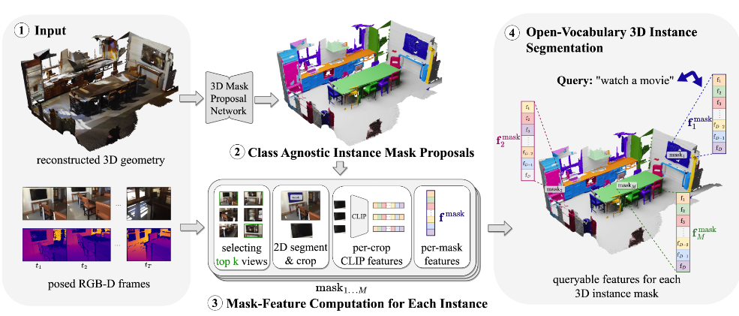
Example Pipeline
Input RGB-D images of a 3D indoor scene and its point cloud.
Generate class-agnostic instance mask proposals using the point cloud.
Compute feature representations for each mask.
Obtain an open-vocabulary 3D instance segmentation, enabling retrieval of objects related to queried concepts in the CLIP
Takmaz et al. OpenMask3D: Open-Vocabulary 3D Instance Segmentation. NeurIPS 2023.
Notes:
So success in the 2D world could guide open-set tasks in 3D. Here is an example pipeline.
Let me give a short introduction:
Total input consists of RGB-D images of a 3D indoor scene and its corresponding point cloud
First, Process the point cloud using the pre-trained Mask 3D model to obtain 3D mask proposals.
then, Project the 3D mask proposals onto 2D images and select the top k images with the most visible points.
Next, the SAM model is applied by inputting the selected image along with a random subset of its visible points to obtain the corresponding 2D mask of the 3D mask in that image.
Step 4: Crop instances based on the mask and input them into the CLIP model to obtain image feature embeddings.
Step 5: calculate cosine similarity calculations between image feature embeddings and text embeddings (from any label or phrase) using the CLIP model for understanding and reasoning.

Slide 7
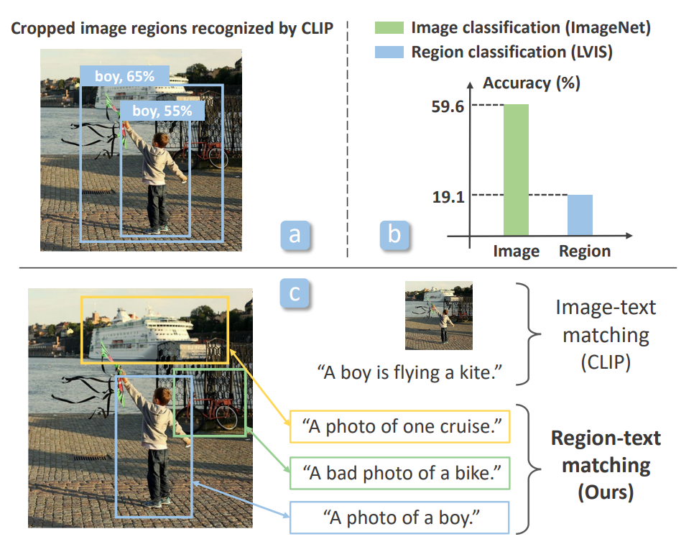
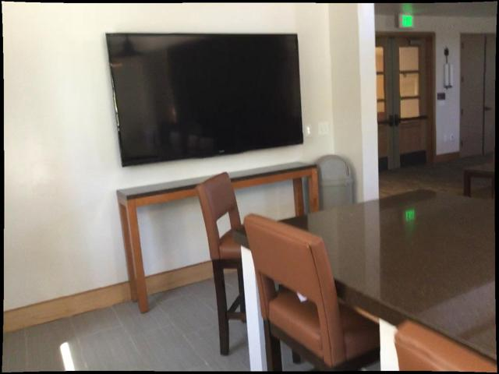
Motivation
Previous methods simply use the original CLIP model without addressing its regional limitations.
Directly applying it for object detection leads to poor performance due to domain shift, as CLIP was trained to match whole images to text descriptions, without capturing fine-grained alignment between image regions and text spans.
?
Y. Zhong et al., RegionCLIP: Region-based language-image pretraining, CVPR,2022.
Notes:
This is a commonly adopted framework in the field; however, we still identify areas with potential for improvement and innovation.
First:
most methods use the original CLIP model but overlook its regional limitations.
Applying it directly to object detection results in poor performance due to domain shift,
As CLIP was trained to match entire images to text descriptions,
without capturing detailed alignment between image regions and text.

Slide 8
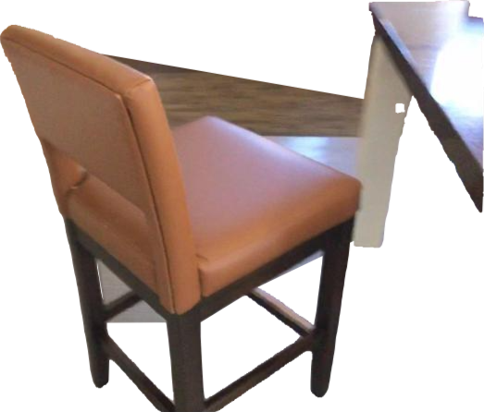
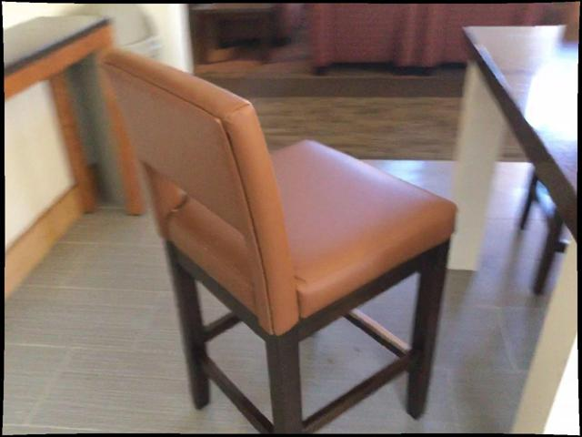
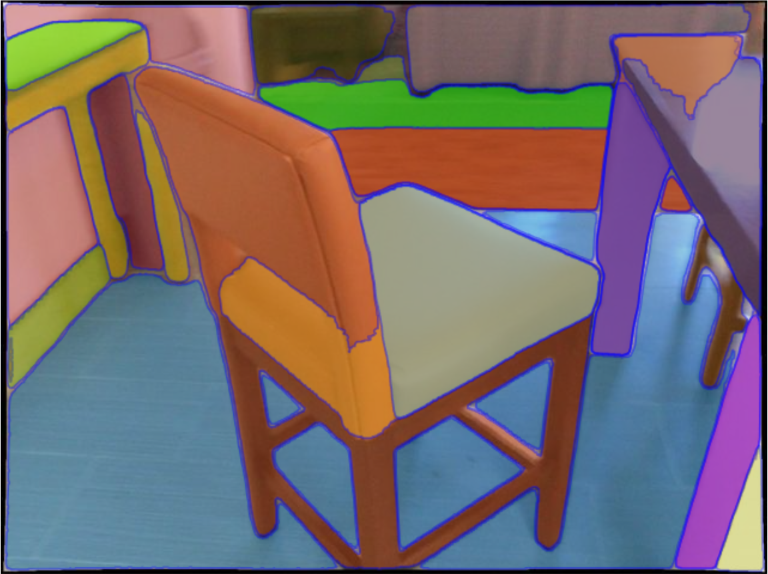
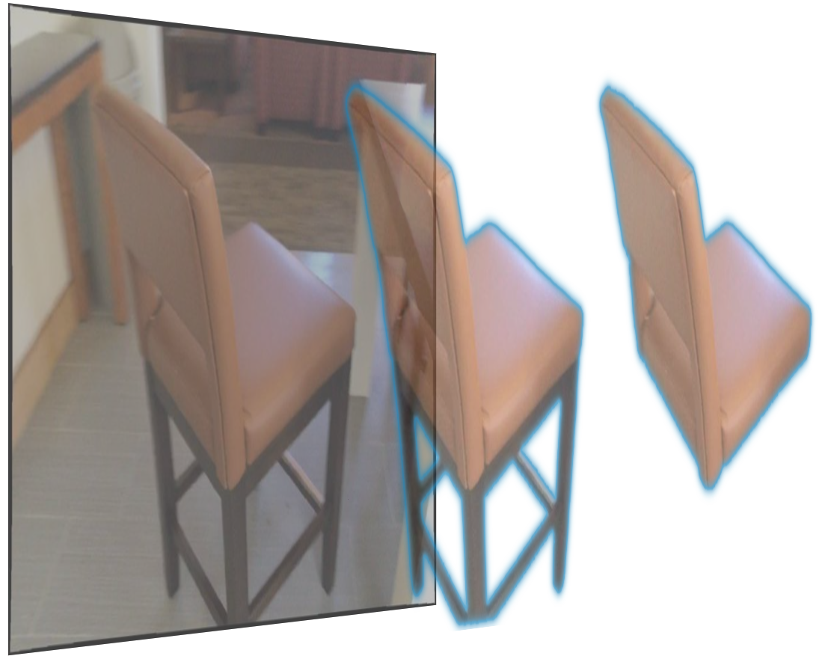
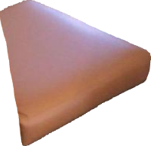
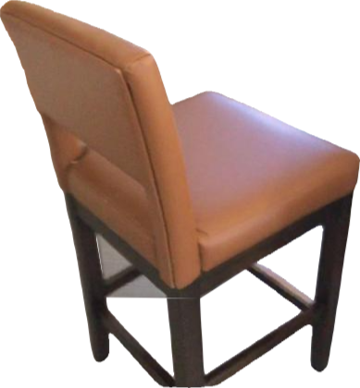
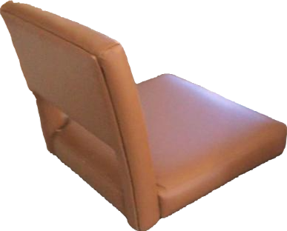
Motivation
2D instance segmentation achieves impressive results and is widely used in 3D open-set tasks.
However, it is important to note that model sensitivity can cause mismatches between 2D segmented regions and 3D mask proposals, which can lead to mismatched inference results in subsequent stages.
Demo from SAM official repo
Notes:
Sceond:
2D instance segmentation achieves strong results and is widely used in 3D open-set tasks.
However, model sensitivity can cause mismatches between 2D and 3D mask proposals,
leading to incorrect inference results in later stages.

Slide 9
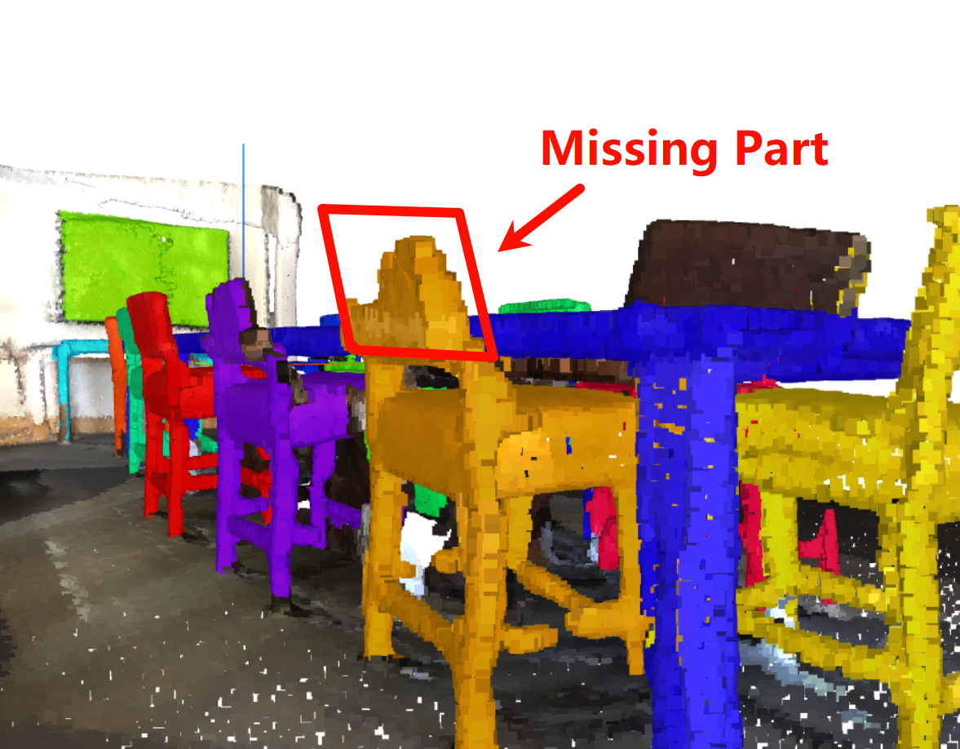
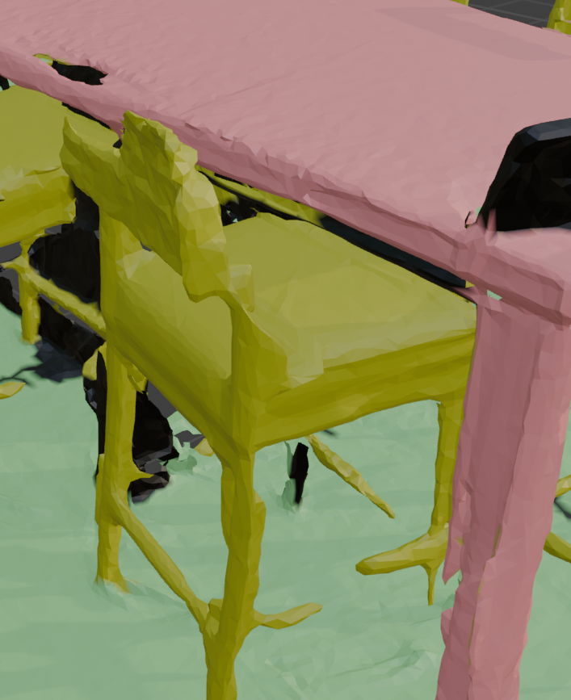
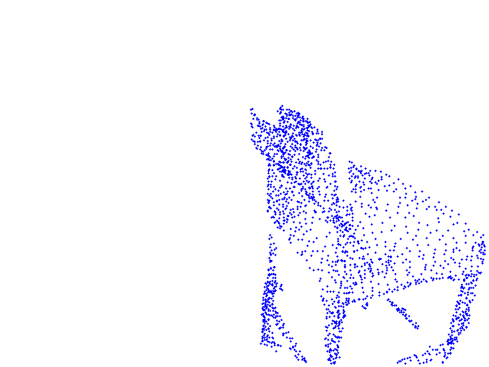
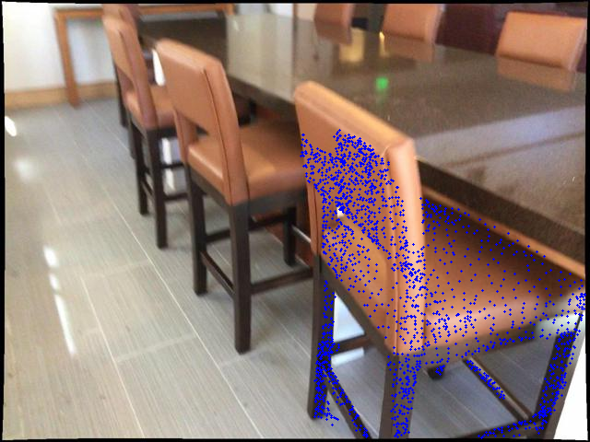
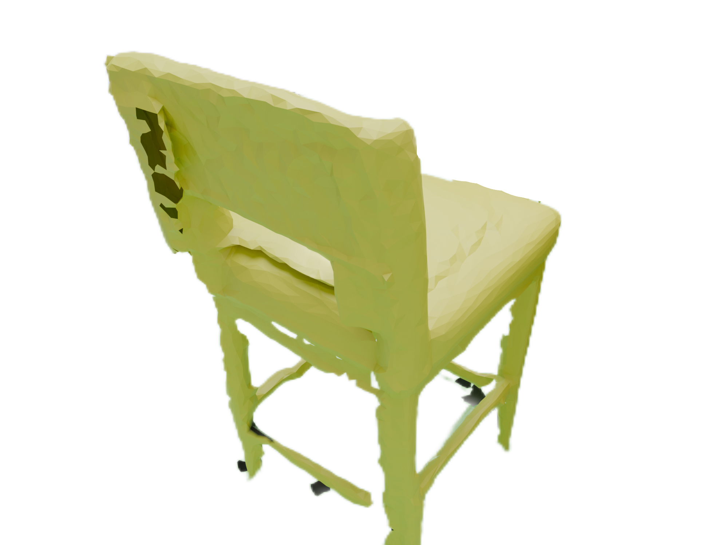
Motivation
Most existing work heavily relies on the mask proposals generated by pre-trained 3D models(like Mask3D), where the quality of these masks directly affects the performance of instance segmentation.
However, open-set tasks should not be constrained by closed-set models. Additionally, prior knowledge from 2D segmentation models can alleviate the limitations observed in current 3D class performance.
Missing
parts
Mask3D
3D Points to 2D Pixels
Ground truth
Notes:
Third:
Most existing work relies heavily on mask proposals from pre-trained 3D models,
where the quality of these masks directly impacting instance segmentation performance.
However, open-set tasks should not be limited by closed-set models.
Additionally, prior knowledge from 2D segmentation models can help address the limitations in current 3D class performance.

Slide 10
Contributions
We proposed MOSS, a mask-based framework for open-set 3D scene semantic segmentation that enables efficient cross-dimensional feature transfer and inference.
We enhanced the frame by implementing global information input with mask constraints to strengthen attention.
We employed a density-guided dilation algorithm to optimize the matching precision between 2D and 3D masks.
We also introduce a novel method to enhance 3D mask proposals, which leverages 2D prior knowledge to perform back-projection on a 3D pre-trained model. This approach guides the capture of superpoint clusters in the 3D scene, thereby improving the quality of the output results of fine-tuning the close-set model result.
Notes:
So here we proposed MOSS, an improved mask-based framework for open-set 3D scene segmentation which could enable efficient cross-dimensional feature transfer and inference.
We identified limitations in 2D pre-trained models, lack of regional recognition and over-sensitivity. then we enhanced the frame by using global information and mask constraints to strengthen regional attention
And employing a density-guided dilation algorithm to optimize the matching precision between 2D and 3D masks.
We also introduce a novel method to enhance 3D mask proposals from close-set model, using 2D prior knowledge to perform back-projection. This approach guides the capture of superpoint clusters in the 3D scene, thereby improving the quality of the 3d mask proposal outputs

Slide 11
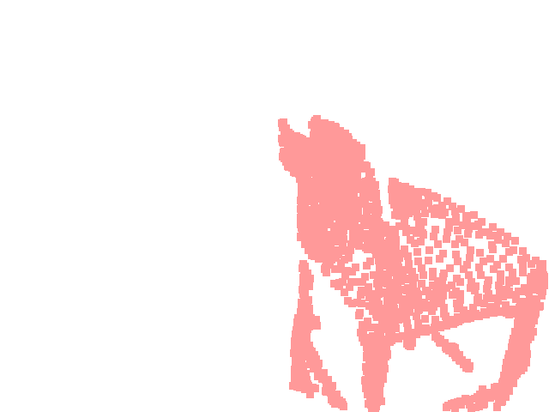
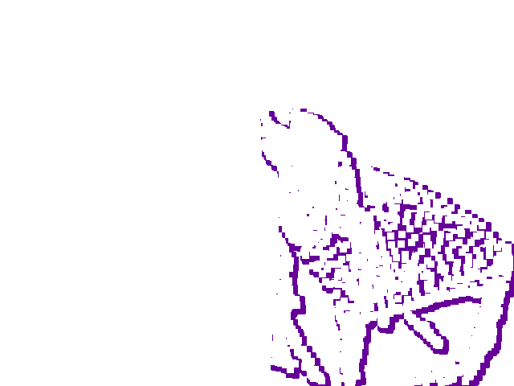
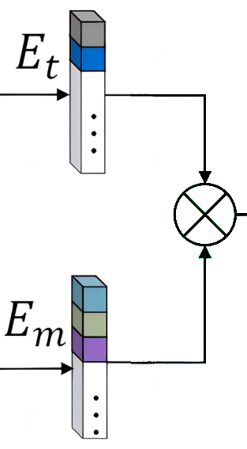
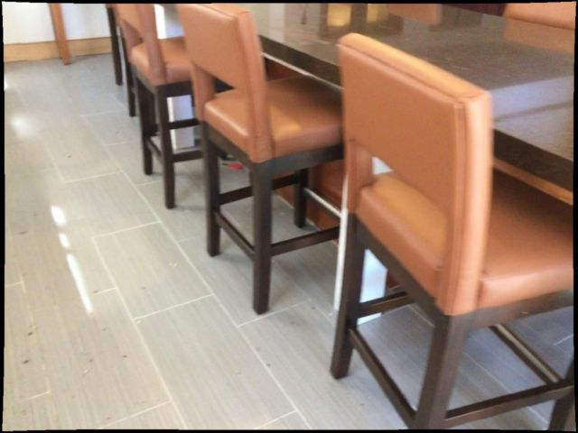
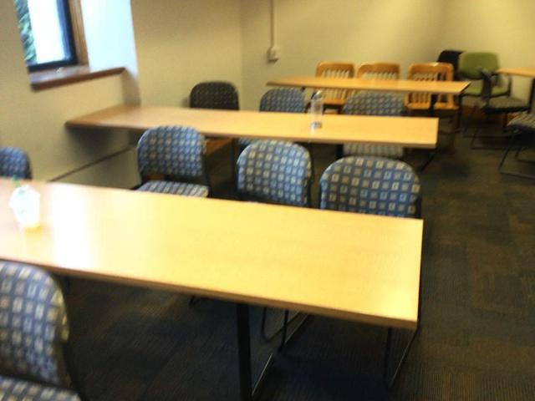
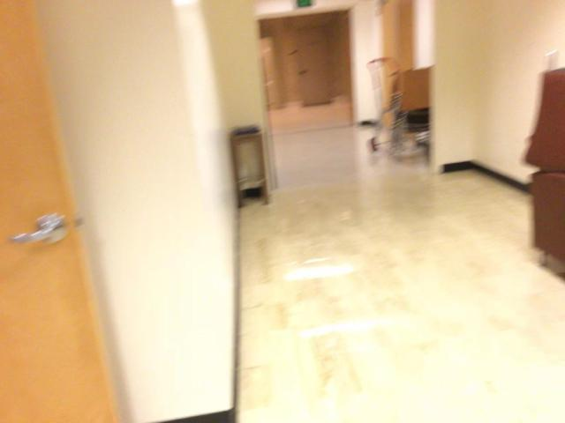
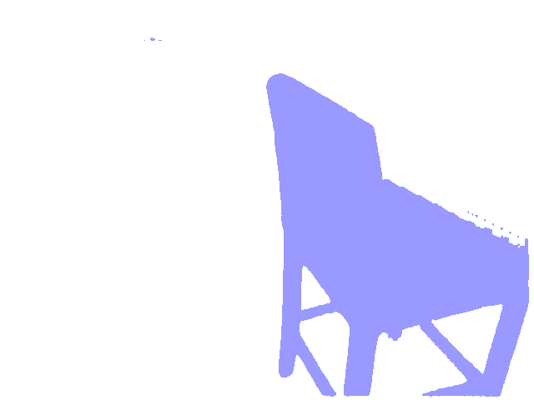
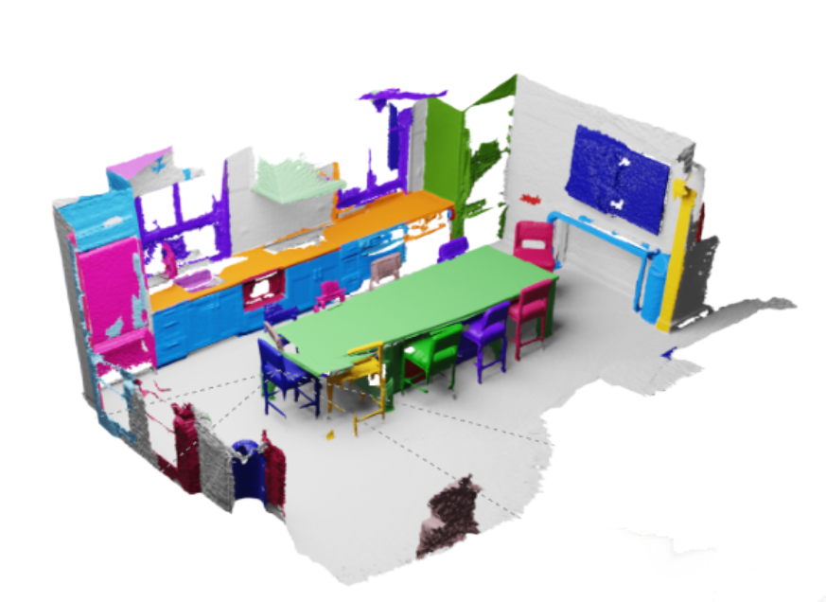
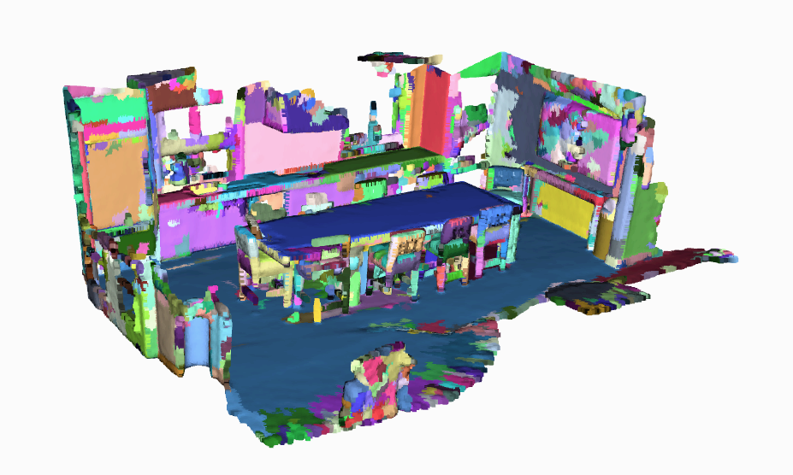
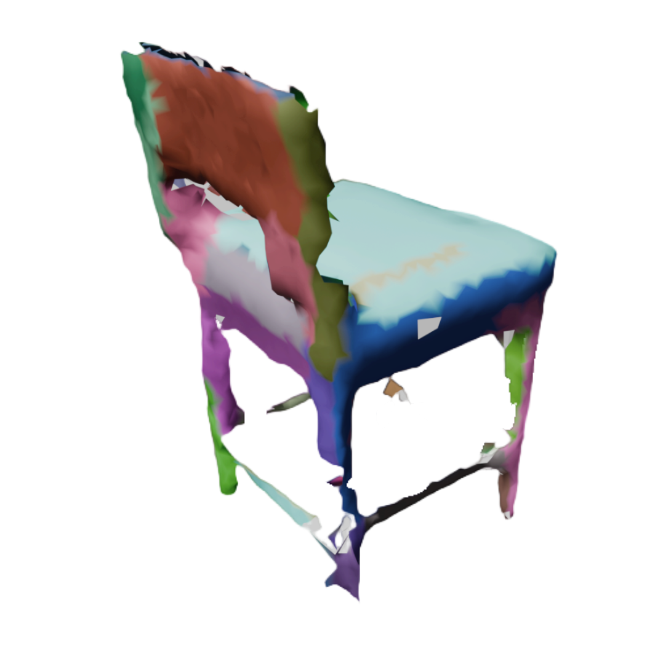
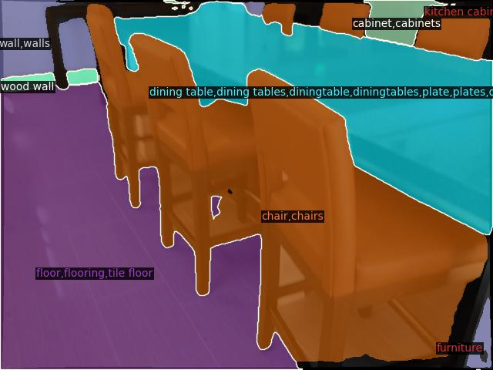
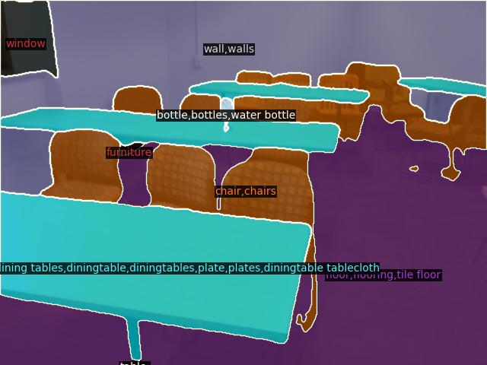
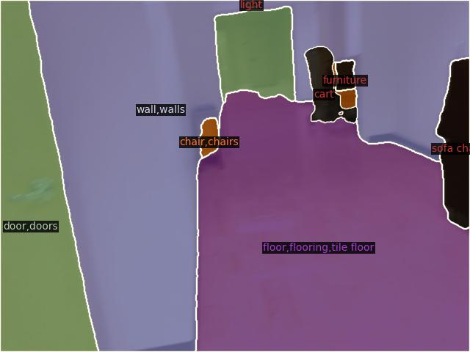
Our Proposed MOSS
Sentence Templates
Open-Set
Label List
Directional
Expansion
CLIP-T
Get 3D Mask Proposals
PSM
consistent alignment
CLIP-T
Input ②
rgbd imag
Encoder
Neck
Guide
Input ① *.ply
2D Mask Generator
Get SuperPoint Groups
HQ-segmentation and pred labels
Merge missing parts
Guide
Notes:
here is the pipeline figure:
now we introduce our approach in the order of the contributions outlined.

Slide 12
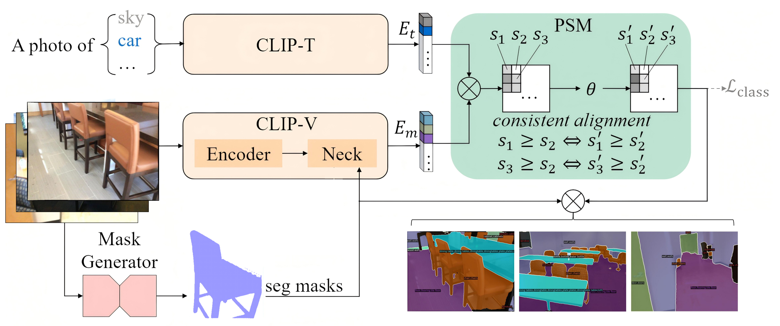
Our Proposed MOSS - Contribution1
Input a cropped image:
Cropped regions lack global information.
Input a purely global image:
Fail to localize the areas that need to be understood.
Lead to inconsistencies in the granularity of classification, where the level of detail may be too fine or too coarse to align with the designated regions of the mask proposal.
Input both global images and masks:
Constrain regions requiring enhanced understanding.
Obtain contextual information to improve inference accuracy.
?
Input ①
Input ②
Zeng et al. MaskCLIP++, a mask-based CLIP fine-tuning framework for open-vocabulary image segmentation, 2024
Notes:
as mentioned before, Inputting a cropped image results in a loss of global context.
Inputting a purely global image fails to localize areas that need detailed understanding.
Also, This leads to inconsistencies in classification granularity, where the level of detail may be either too fine or too coarse to match the mask proposal regions
So, inputting both global images and masks, we can constrain the regions needing enhanced understanding and obtain contextual information to improve inference accuracy at the same time.
the 2D mask, with its clear boundaries plays a crucial role

Slide 13
How to obtain a high-quality 2D mask?
Notes:
Then how can we to obtain a high-quality 2D mask?

Slide 14
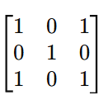
Our Proposed MOSS - Contribution2
Density-based Directional Expansion Algorithm
❎
❎
❎
✅
IOU?
The number of pixels does not correspond
① Expansion in the equal direction
② Directional expansion based on density
③ ...
④ Calculate IoU
> the threshold
Notes:
Our goal is to obtain a 2D mask that closely matches the 3D mask, meaning the 2D mask needs to tightly align with the points projected onto the 2D image.
The Intersection over Union (IoU) metric can effectively measure the overlap between the two regions, helping to determine when a high-quality 2D mask has been obtained.
However, the number of pixels corresponding to the SAM mask and the scattered points are inconsistent, rendering such calculations ineffective. Additionally, other contour detection algorithms, such as the convex hull algorithm, struggle with contours of varying shapes.
Therefore, we propose a density-based, anisotropic expansion method. The algorithm's logic is as follows:
In the initial phase, all scattered points are treated as equally directed, expanding outward with a specified step size from their center, thereby affecting neighboring pixel regions.
Subsequently, the expansion density is calculated within a defined window to obtain a density distribution.
During the next expansion round, the process continues toward higher-density areas. Finally, the result is matched and filtered against the mask output by SAM.

Slide 15
What else can a high-quality 2D mask offer?
Notes:
What else can a high-quality 2D mask offer?
This is our third contribution

Slide 16
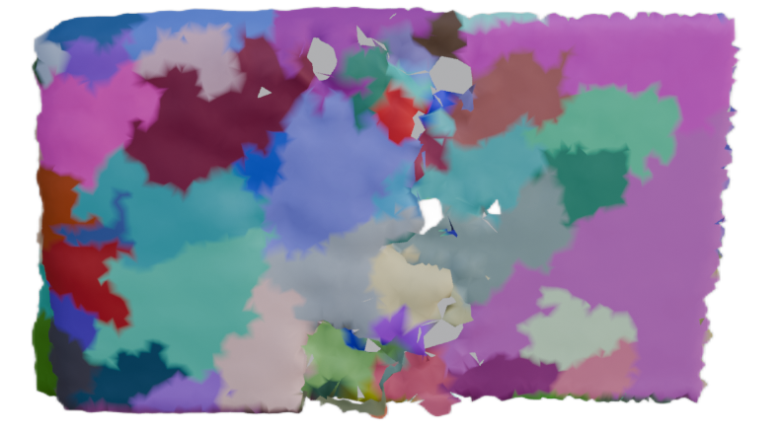
Our Proposed MOSS - Contribution3
Fine-Tuning of 3D Mask Proposals based on SuperPoints
Missing
parts
The coarse 3D mask proposal has missing areas compared to the ground truth.
The prior knowledge from the 2D can fill these gaps.
Pixels from the 2D mask are projected to 3D, and the matching points are added to the 3D mask.
To improve efficiency, the raw point cloud is transformed into superpoint clusters.
SuperPoints: points are grouped into geometrically homogeneous regions.
Instead of individual points, superpoint clusters are used as the unit for merging.
Ground truth
Notes:
The coarse 3D mask proposal has missing areas compared to the ground truth,
which can be filled using prior knowledge from the 2D mask.
Pixels from the 2D mask are projected to 3D space, and the matching points are added to the 3D mask.
To improve efficiency, the raw point cloud is transformed into superpoint clusters.
Superpoints group points into geometrically homogeneous regions,
and these clusters are used for merging instead of individual points."
By doing so, we have achieved the completion of the coarse mask,
thereby improving the segmentation accuracy of the 3D scene.

Slide 17
Experiments & Results (Imcomplete)
Method | mAP | mAP50 | mAP25 | head | comm | tail
Mask3D (Closed Vocab.) | 26.9 | 36.2 | 41.4 | 39.8 | 21.7 | 17.9
SAM3D | 6.1 | 14.2 | 21.3 | 7 | 6.2 | 4.6
OVIR-3D | 13 | 24.9 | 32.3 | 14.4 | 12.7 | 11.7
Open3DIS | 23.7 | 29.4 | 32.8 | 27.8 | 21.2 | 21.8
OpenScene (2D Fusion) | 11.7 | 15.2 | 17.8 | 13.4 | 11.6 | 9.9
OpenScene (3D Distill) | 4.8 | 6.2 | 7.2 | 10.6 | 2.6 | 0.7
OpenScene (2D-3D Ens.) | 5.3 | 6.7 | 8.1 | 11 | 3.2 | 1.1
OpenMask3D | 15.4 | 19.9 | 23.1 | 17.1 | 14.1 | 14.9
OpenMask3D(Our Step2) | 16.2 | 21.3 | 24.8 | 22.2 | 13.4 | 12.5
Open3DIS | 18.6 | 23.1 | 27.3 | 24.7 | 16.9 | 13.3
Open-YOLO 3D | 24.7 | 31.7 | 36.2 | 27.8 | 24.3 | 21.6
MOSS(Ours) | 25.2 | 32.7 | 36.5 | 25.6 | 25.2 | 25.9
* The experimental results are still being updated
(hyperparameters are being finalized)
Notes:
These are the evaluation results under our current framework, compared with other models.
Our performance has surpassed the state-of-the-art (SOTA) results,
and there is potential for further improvement as the hyperparameters are being finalized.

Slide 18
Phase Summary & Next Work
Tasks in the 2D domain can successfully guide 3D spatial understanding tasks;
The instance matching between 2D and 3D in the form of masks works effectively
Conduct experiments with additional datasets;
Attempt to replace the black-box CLIP model with an integrated VLM (Visual-Language Model) during the inference phase;
Optimize code details to reduce the inference time per scene.
Notes:
Tasks in the 2D domain can really help guide 3D spatial understanding tasks.
The instance matching between 2D and 3D using masks has proven to be effective.
Next steps include running experiments with additional datasets
and trying to replace the black-box CLIP model with an integrated Visual-Language Model (VLM) during inference.
We also plan to optimize some code details to reduce the inference time for each scene.

Slide 19
Research Statement
Summer Research Internship Ver.
My research interests:
Currently lie in open-set tasks for 3D scenes and AIGC for 3D vision.
In the future, I aim to explore the application of generative models in 3D reconstruction tasks and 3D scene re-editing.
My preferred paper from the group:
...

